Slide 1

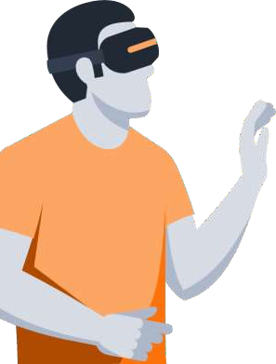
Higher form of AR and VR
Organization: IT Day Hackathon, Rajasthan
Theme : Student’s Learning
Problem Statement Title: A Virtualized and cost friendly Approach to Studies for the student to learn things in immersive manner.
Team Name: Solar Hackers
Team Leader Name: Prakash Thakur
Institute Name: Gyan Ganga College of Technology, Jabalpur (MP).

Slide 2
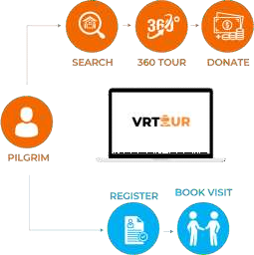




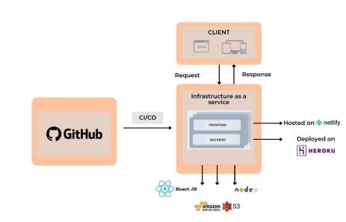
IDEA Details
General Description of Idea:
IDEA:
- A virtual platform that takes a unique approach to learn their syllabus subjects with immersive and interactive manner, this will create personalized and engaging learning experience that faster learning, critical thinking ,creativity ,visualization and collaboration. A platform ideal for individuals who are eager and want to learn practically. It can help serve as a guide for students ,plus enhancing the experience in real time visit.
CONTACT
AR/VR
LOCATION
INFO
SOLUTION:
Azure
Visually Satisfying
Elderly and Challenged Devotees can explore 360° view of all subjects all over India.
Save Time & Cost
Devotees can virtually attend the class Immersive from the comfort of theirhome withoutany extra cost.
User Experience
Smooth booking process, supporting several languages and audio transcript.

Slide 3


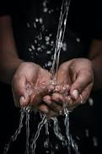


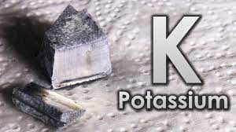
Key Aspects of Model
Virtual Reality (VR) is an immersive technology that transports users into a completely digital environment. By wearing a VR headset, users can experience a completely different world, interact with virtual objects, and even feel as if they are really there.
Augmented reality, or AR, is a technology that overlays digital information onto the physical world around you, creating an interactive and immersive experience.
Using AR and VR Technology in learning will be effective way to engage students to enhance their understanding and visualization by providing interactive environment for each topic practically.
By leveraging the immersive and interactive nature of these technologies we create personalized and engaging experience that enhance their critical thinking, creativity, simulation collaboration and team management etc.
In Students dashboard we show their performance graph, provide them analysis of their activity and based on their activities we recommend them improvement areas etc.
We had seen that many students are not comfortable with English and feel demotivated mostly Hindi medium, In future we will create AI model Character (Avtar) with real time voice capturing and interacting in that language in which they want.
Some time Students not grab given topics like if we are learning about history architecture so we provide them before and after view of architecture with all session view of any tourist place.
2H2 + O2 = 2H2O
Options

Slide 4
IDEA Details
Use Case:
Some Salient Features
To promote Indian culture and digitalized immersive learning of the world and to ensure that users remain emotionally linked to their deity even from the comfort of their homes.
360 degree view of all major concepts of subjects, tourist places and historical place
Exact location of the place using Google Map API.
If we talk about concepts in complex topics, monuments or historical buildings and popular tourists places that are mentioned in books , let's say HAWA MAHAL, then it won't be feasible for viewers to visualize the massive structure through a normal photograph. So, we plan on creating this 360 view for the viewers who are virtually visiting , in order to get the clear and majestic view of the monument.
New Blogs for latest news , information and updates regarding topic concepts, pilgrimages.
Online donations system reaching directly to the temples through online portal.
Progress report ,recommendation of topics and Contact /support in case of any queries.
Book slots for the next visit through the website.
Book an online or offline private tour through our website. (Supports many nationalities all over the world)
AI Chatbot support system for shortlisting t o p I cs which students want to visit.
Ticket booking system and ancient history of booked
places along with PDF generator for places.
People who are unable to leave their homes can directly feel the ambience of the topics and places.

Slide 5
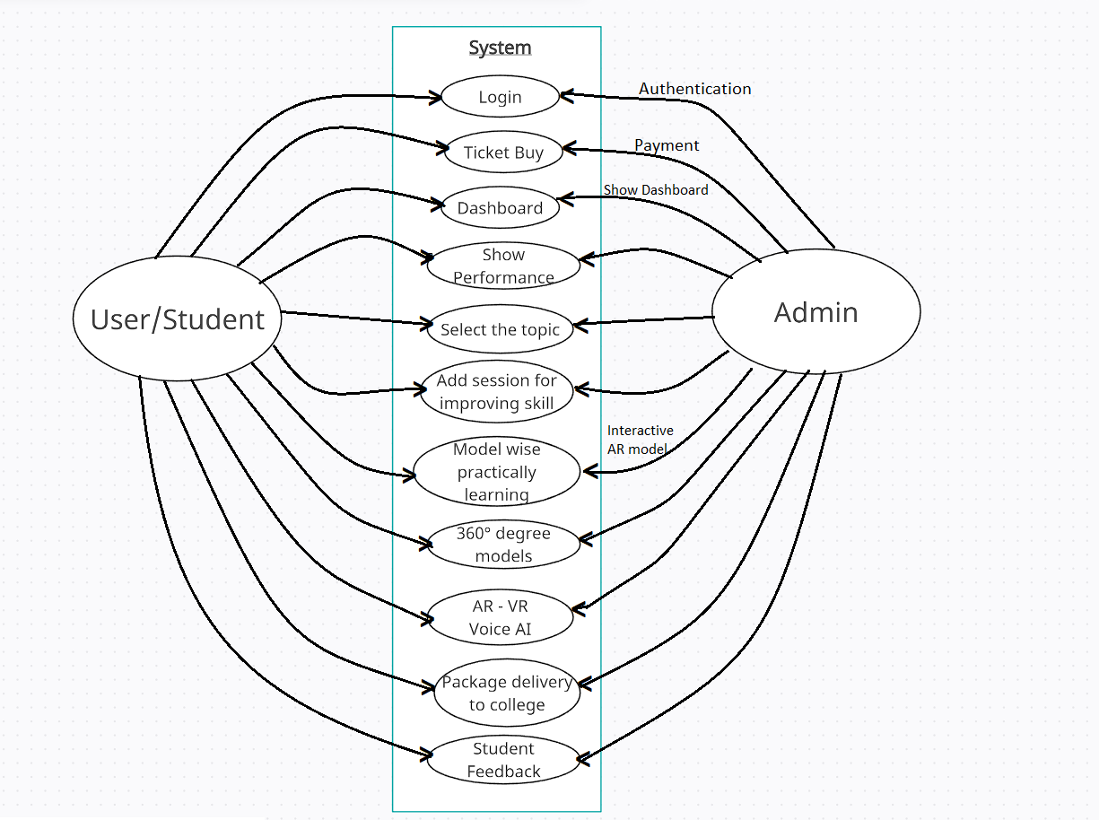
Use Cases

Slide 6
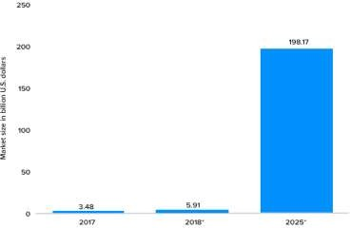
Future Scope and Importance
According to the given graph, the scope of AR/VR in the recent years has been rapidly increasing and it is expected to stay the same way in the upcoming years.
The travel and tourism industry has witnessed
tremendous growth with this emerging technology.
In today’s fast-paced world, travellers love the ease of searching and booking tours on the go, virtually from the comfort of their own places.
It would act as a great tool for the disabled , offering them a source of knowledge, great experience resembling reality with a sense of aesthetic joy.
Dependencies and case study
It would also possess a great potential in the field of education ,wherein students would be offered an opportunity to explore and learn along with their text-based studies.
The user must have an VR headset or smart glasses to experience Virtual Tourism .
Camera permission should be granted while using the website. (for the purpose of seeing the Augmented Reality).
ADs and third-party cookies should also be allowed, so that we can provide a better user experience.
Latest version of web browsers ,like Chrome, Firefox, Edge, etc., is necessary in order for the website to work smoothly.

Slide 7
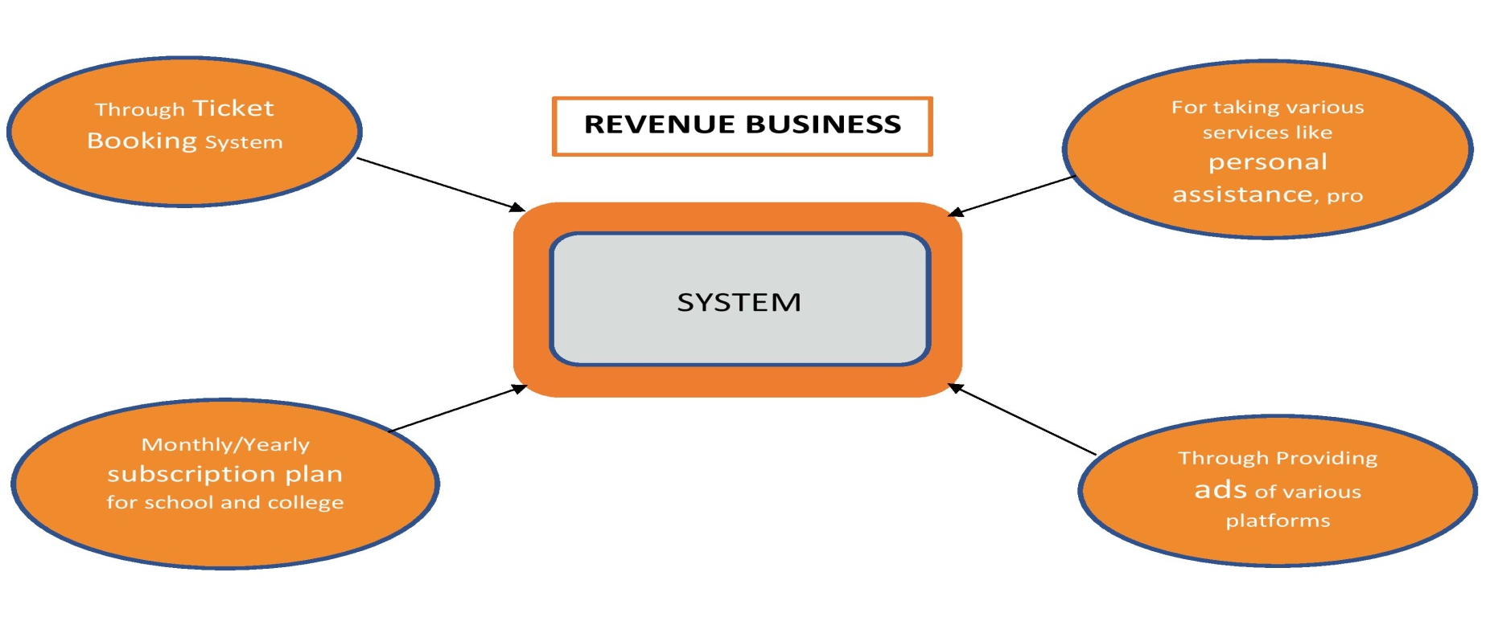
REVENUE MODEL
Marketing strategies
Our marketing will be this:-
We will publish the QR-code of our website in newspapers/magazines through which users can directly visit our website.
We will be running ads of our website on different platforms and many more.

Slide 8
KEY Objective
Easy registration and login :- The login functionality in our AVR Tour is to ensure a good user experience.
Accessibility :- This platform let users to access their old and new records as and when they need it. Storing all data on the cloud is not only secure, it also ensures that the their visit records are available for their future reference as well as for the accessibility.
Data encryption :- The privacy of users with all records, and other sensitive information is secure and cannot be leaked to any third party software. This makes data secure in the app and the data cannot be illegally be changed with other prescription.
Readability :- The usage and understanding of the platform is very easy. User can find it as a child play to operate this app.
Interoperability :- The ability of this application to connect and communicate in a coordinated way, without effort from the end user is very accurate.

Slide 9
TEAM
Team Leader Name: Prakash Thakur
Branch (Btech/Mtech/PhD etc): Btech | Stream : CSE | Year : III
Team Member 1 Name: Abhinay Chadar
Branch (Btech/Mtech/PhD etc): Btech | Stream : CSE | Year : III
Team Member 2 Name: Nishsar Meshram
Branch (Btech/Mtech/PhD etc): Btech | Stream : CSE | Year : III
Team Member 3 Name: Nitin Sanodiya
Branch (Btech/Mtech/PhD etc): Btech | Stream : CSE | Year : III

